Slide 1

Phone Time
A presentation by: Rotem Gera and Shlomo Koppel

Slide 2

What We Do
We monitor the time you spend on every app on your phone, helping you divide your time in a smart way
If you wish to block an app due to over use or addiction – we can help you with that too
These are both done with an easy to use interface, allowing you to evaluate, monitor and compare the time you spend on various apps

Slide 3
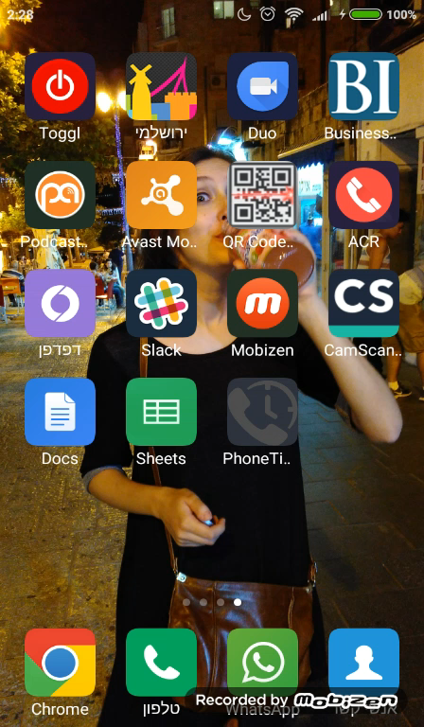
Demonstration

Slide 4

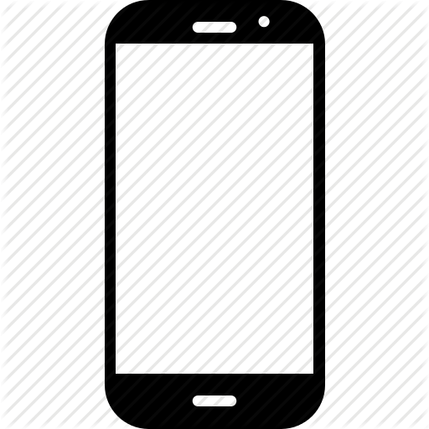
System Structure
Each phone is identified by a combination of the sim card number, the device id and the android provider id.
These numbers are mashed together and securely hashed so that no phone can be accessed except by the phone owner.

Slide 5
System Structure
Every 10 seconds, when the screen is on, a service runs in the background of the phone and checks the current app running
If the app is not a system application- the phone will send the app package that is running in the foreground to Firebase.
Even in the case of a user that is currently not connected to internet- the data will be sent latter on.
Furthermore, the running app is compared to the apps in the blocked list, which is also saved via Firebase, and in case the user “crossed the line”, he or she is blocked accordingly.
Besides the package name, a time stamp is sent in order to determine the time of use.

